Slide 1


Dr. N.G.P. INSTITUTE OF TECHNOLOGY
Coimbatore - 48
(An Autonomous Institution)
DEPARTMENT OF INFORMATION TECHNOLOGY
USED CAR PRICE PREDICTION USING MACHINE LEARNING MODEL
Team Members
Mr. HARISH.M (710720205015)
Mr. HARISH.V (710720205016)
Mr. NAVEEN.V (710720205034)
Mr. VIGNESH.M (710720205304)
Guided By
Mr.P.Rajasekaran M.E, (Ph.D)
Assistant Professor(SS)/ IT

Slide 2
OUTLINE
Objective
Literature Survey
Problem Statement
Existing Algorithms
Proposed Algorithms
Hardware & Software Specifications
Data Flow Diagram
Performance Parameters
Modules
Conclusion
References
USED CAR PRICE PREDICTION USING MACHINE LEARNING MODEL
2

Slide 3
OBJECTIVE
The aim of this project is to predict the price of used cars using the Machine Learning (ML) model.
USED CAR PRICE PREDICTION USING MACHINE LEARNING MODEL

Slide 4
LITERATURE SURVEY
S. No. | Title of the Paper | Author Details | Publication & Year | Remarks
1. | Car Price Predictor | Ms. P. A. Satarkar , Siddhi B. Shitole , Soniya S. Kagade , Shivani S. Awatade , Sakshi M. Kotalwar | IEEE, June 2022 | In this paper, the price range is not accurate.In this technique the model used is multiple regression and the accuracy of the predicted value is not as much as acceptable.
2. | Car Price Prediction | Praful Rane, Deep Pandya, Dhawal Kotak | IEEE, April 2021 | In this paper, global market is not more updated and price is not calculated accurately. The method used here is Linear regreesion technique and the possible ways of predicting the price is quite difficult for large datasets.
3. | Car Price Prediction Using Machine Learning | Ketan Agrahari , Ayush Chaubey , Mamoor Khan, Manas Srivastava | IEEE, June 2021 | In this paper, Unsupervised machine learning models are used. The prediction analysis makes a difference with the values and the price is not more satisfied for the test sets.
USED CAR PRICE PREDICTION USING MACHINE LEARNING MODEL

Slide 5
LITERATURE SURVEY(Contd…)
S. No. | Title of the Paper | Author Details | Publication & Year | Remarks
4. | Price Prediction of Used Cars Using Machine Learning | Mr. Ram Prashath R, NIthish C N, Ajith Kumar J | IGRASet & Mar 2019 | In this paper, the prediction analysis is not accurate. The price prediction method follows the train and test sets to predict the values and the analysis part is only applicable for limited number of dataset.
5. | Used Car Price Prediction using K-Nearest Neighbor Based Model | K.Samruddhi ¸ Dr. R.Ashok Kumar | IEEE, September 2020 | In this paper, KNN ML model is used but they doesn’t use train and test set. The KNN machine learning technique give the predicted value with large dataset. The analysis part is way to processing the datasets and predict the price.
USED CAR PRICE PREDICTION USING MACHINE LEARNING MODEL

Slide 6
PROBLEM STATEMENT
It is easy for any company to price their new cars based on the manufacturing and marketing cost it involves.
But when it comes to a used car it is quite difficult to define a price because it involves it is influenced by various parameters like car brand, manufactured year, Kilometers driven and etc.
The goal of our project is to predict the best price for a pre-owned car in the Indian market based on the previous data related to sold cars using machine learning.
USED CAR PRICE PREDICTION USING MACHINE LEARNING MODEL

Slide 7
EXISTING ALGORITHMS
Predicting price of a used cars has been studied extensively in various researches. The regression model that was built using Support Vector Machines (SVM) can predict the price of a car that has been leased with better precision than multivariate regression or some simple multiple regression.
This is on the grounds that Support Vector Machine (SVM) is better in dealing with datasets with more dimensions and it is less prone to overfitting and underfitting. The weakness of this research is that a change of simple regression with more advanced SVM regression was not shown in basic indicators like mean, variance or standard deviation.
Existing Algorithm:
Multiple Regression , Support Vector Machines Algorithm.
USED CAR PRICE PREDICTION USING MACHINE LEARNING MODEL

Slide 8
PROPOSED ALGORITHMS
Proposed System:
In this system, a car’s data set is used. The aim is to predict the possibilities of price for Used cars.
These models are used to enhance the accuracy level of the classification technique which performs both classification and prediction methods. This proposed method increase the accuracy of the prediction.
Algorithm:
Lasso Regression.
Features:
Brand
Model of Car
Year of Manufacture
Fuel Type
Kilometers driven
USED CAR PRICE PREDICTION USING MACHINE LEARNING MODEL

Slide 9
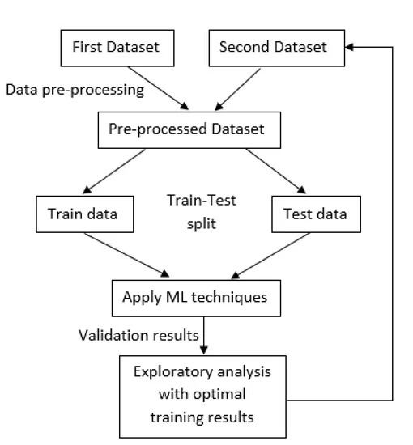
DATA FLOW DIAGRAM
USED CAR PRICE PREDICTION USING MACHINE LEARNING MODEL

Slide 10
HARDWARE & SOFTWARE SPECIFICATIONS
HARDWARE SPECIFICATIONS
RAM : 4 GB
Data set Storage : 500 MB
CPU : 2 GHz
Architecture : 32-bit,64-bit,
Minimum core : i3 processor,
Program Storage Maximum : 50mb
SOFTWARE SPECIFICATIONS
Python 3.7
Pycharm (For Website Development)
Jupyter Notebook (For Analysis)
USED CAR PRICE PREDICTION USING MACHINE LEARNING MODEL

Slide 11
PERFORMANCE PARAMETERS
Time:
It reduces the time for predicting the Price of the Used Cars in a efficient manner.
Cost:
It is less cost efficient.
Quality:
It gives great response to the users who are using it,to check the price of the used cars for both Buyers and sellers. Produced the final result whether the accuracy is maintained with the range of the price of the Car.
USED CAR PRICE PREDICTION USING MACHINE LEARNING MODEL

Slide 12
Modules
The development of Used Car price prediction using Machine Learning model consist of 2 module:
Module– I : Data Collection & Preprocessing
1. Brand
2.Model
3.Year of Manufacturing
4.Fuel Type
5.Kilometers driven
Module – II : Modeling & Prediction
USED CAR PRICE PREDICTION USING MACHINE LEARNING MODEL

Slide 13
CONCLUSION
Car price prediction can be a challenging task due to the high number of attributes that should be considered for the accurate prediction.
The major step in the prediction process is collection and preprocessing of the data.
Although, this system has achieved astonishing performance in Used car price prediction problem that aim for the future research is to test this system to work successfully with various data sets.
USED CAR PRICE PREDICTION USING MACHINE LEARNING MODEL

Slide 14
REFERENCES
[1] Agencija za statistiku BiH. (n.d.), retrieved from: http://www.bhas.ba . [accessed July 18, 2018.]
[2] Listiani, M. (2009). Support vector regression analysis for price prediction in a car leasing application (Doctoral dissertation, Master thesis, TU Hamburg-Harburg).
[3] Richardson, M. S. (2009). Determinants of used car resale value. Retrieved from: https://digitalcc.coloradocollege.edu/islandora/object /coccc%3A1346 [accessed: August 1, 2018.]
[4] Wu, J. D., Hsu, C. C., & Chen, H. C. (2009). An expert system of price forecasting for used cars using adaptive neuro-fuzzy inference. Expert Systems with Applications, 36(4), 7809-7817.
[5] Du, J., Xie, L., & Schroeder, S. (2009). Practice Prize Paper—PIN Optimal Distribution of Auction Vehicles System: Applying Price Forecasting, Elasticity Estimation, and Genetic Algorithms to Used-Vehicle Distribution. Marketing Science, 28(4), 637-644.
USED CAR PRICE PREDICTION USING MACHINE LEARNING MODEL

Slide 15
THANK YOU
USED CAR PRICE PREDICTION USING MACHINE LEARNING MODEL

